Slide 1
Reinforcement Learning for Delay-Constrained Network Optimization
Wenjie Xu
Gongpu Chen

Slide 2
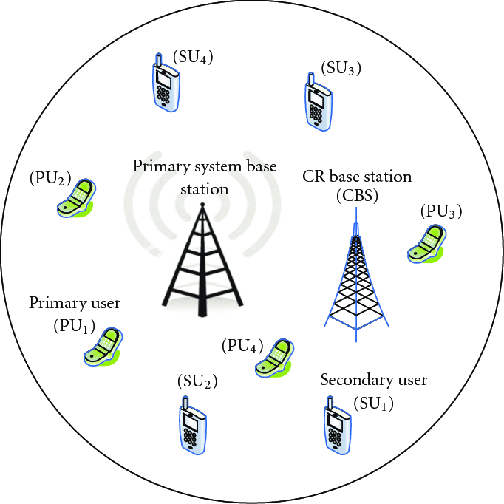
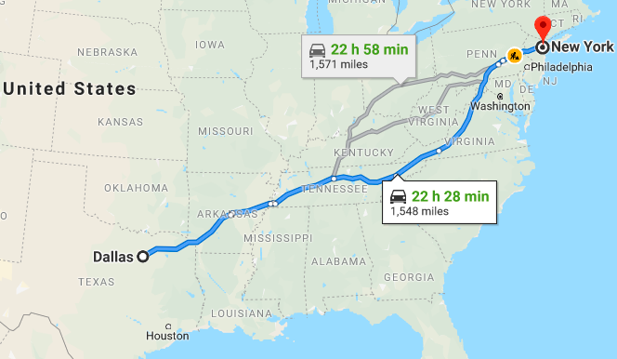
Problem Description
Path selection and cost optimization for multi-hop
delay-constrained networks
Goal: Minimize the cost while satisfying a hard deadline constraint
NP-hard, existing algorithms[FPTAS, etc.] can’t scale up
Timely truck transportation
[TITS’ 18, etc.]
Cognitive radio network communication
[TMC’ 16,etc.]

Slide 3

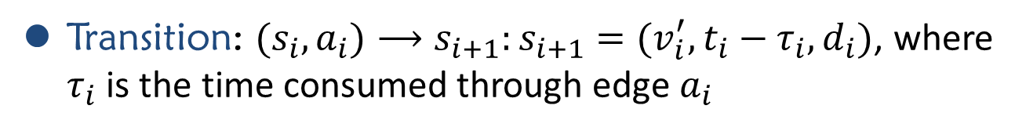
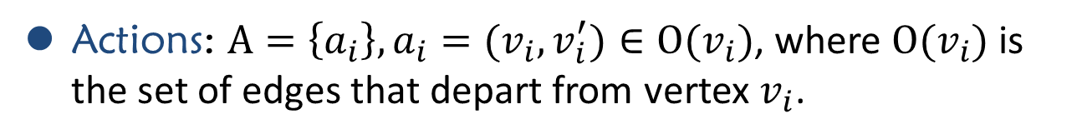
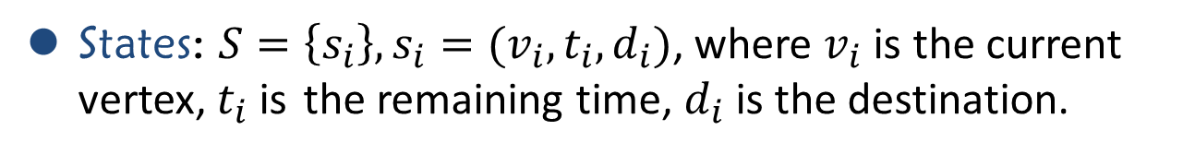

MDP Formulation
States: $S=\left\{s_{i}\right\},s_{i}=(v_{i},t_{i},d_{i})$, where $v_{i}$ is the current vertex, $t_{i}$ is the remaining time, $d_{i}$ is the destination.
Actions: $A=\left\{a_{i}\right\},a_{i}=(v_{i},v_{i}^{′})∈Ο(v_{i})$, where $Ο(v_{i})$ is the set of edges that depart from vertex $v_{i}$.
Transition: ${(s}_{i},a_{i})⟶s_{i+1}:s_{i+1}=(v_{i}^{′},t_{i}−τ_{i},d_{i})\text{,}$ where $τ_{i}$ is the time consumed through edge $a_{i}$
S
Terminated states: $t_{i}<0⇒$fail; $v_{i}=d_{i}⇒$success
1
2
Rewards: $−c_{i}$, minus cost of each edge
($τ_{i},c_{i}$)
3
4
d

Slide 4

Q-value Function Approximation
State $s_{i}=(v_{i},t_{i},d_{i})⟹$ Some feature capturing the graph structure
Structure2Vec: [NeurIPS’ 17]
After T iterations

Slide 5
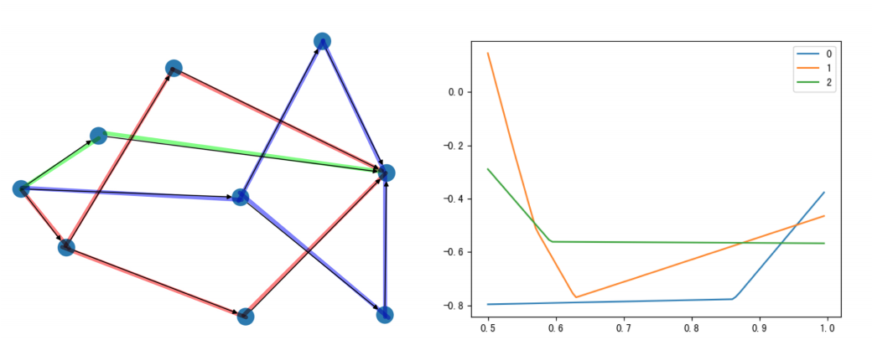
Current Progress
Environment setup
Q-value function approximator for our problem
$$f_{v}^{(t+1)}=θ_{1}d+θ_{2}\min_{u}{c(e\left(v,u\right))}+θ_{3}\min_{u}{t(e\left(v,u\right))}+\left(θ_{4}+θ_{5}t_{r}\right)I_{v}+θ_{6}\sum_{u}{\frac{f_{u}^{(t)}}{|out(v)|}}$$
Parameter tuning …
A simple graph, three feasible actions for the leftmost node
Impact of budget time on the Q values of the three state-action pairs

